Slide 1
Data Mining Algorithm in Volleyball Match Tech. & Tactical Analysis
A complete overview of algorithm
- Vishnu Vardhan Reddy Yeruva

Slide 2
Decoding Data Mining
In every scenario of an application which is involved with any of the Data Mining techniques will be categorized into three different parts.
Data Management
Data Acquisition/ Collection
Data Analysis and Processing
In this paper we are in need of better interface where volleyball coaches needed to analyze their competitors team tactics. So, moving with fourth option as well
4. System Management

Slide 3
Data Management
In this particular scenario data obviously will be different teams, different players information and if possible the win to loose ratio of each side of the court

Slide 4
Data Acquisition/ Collection
Data collection will never be easy, the same follows in this case as well because volleyball is to change the score by turns, and in the process of each round, there are 12 players in two teams at the same time
Volleyball requires high speed like player number, ball landing area, …etc. which requires high real-time performance.
Therefore the data collection also staged into two
Keyboard Acquisition
Mouse Acquisition

Slide 5
Data Acquisition contd…
Keyboard Acquisition: the main advantage of keyboard acquisition mode is faster acquisition speed, and the disadvantage is that the accuracy is slightly lower than that of mouse acquisition.
Mouse Acquisition: Mouse acquisition has advantages in acquisition accuracy, but due to the limited collection interface, it can not cover all scripts, so it has certain limitations.
In this scheme, the combination of mouse acquisition and keyboard acquisition is used to improve the collection efficiency.

Slide 6
Data Analysis & Processing
Data Processing will be done to eliminate ambiguity and to improve quality of data in a brief. Now this seems to be a little lengthy at least for me. So, let me divide this into few stages
Script Description Language
Data Classification
Statistical Analysis

Slide 7
Scripting
In order to collect competition data more quickly and accurately, it is necessary to design a pattern based script description language.
The scripting language that is used here is Chinese character Pinyin-stroke coding
According to the natural structure features of Chinese characters, the Chinese characters are divided into three-part characters, two-part characters and single-part characters, and the Chinese characters can be divided into horizontal (rising) stroke, vertical stroke, left-falling stroke, dot (right-falling) stroke and turning stroke according to the strokes
Scripting happens on data which is collected in two fromats.

Slide 8
Scripting contd…
The first is convenient memory. For the choice of characters, the first letter of Pinyin is generally chosen, such as “F” for serve, “g” for attack and “1” for block.
The advantage of this choice is that as long as people can say the word, they can immediately associate with the code that represents the phrase, which provides great convenience for memory.
But there is an ambiguity here it uses another character to represent one of the words.

Slide 9
Scripting contd…
The second method is that words with different meanings can be described by the same symbols if they are not in the same category.
This ambiguity can be overcome in the process of script parsing through the design of script parser. Script parser expands the availability of words.
this topic tries to choose those keys that users can easily touch, or only need to press a key to record characters.

Slide 10
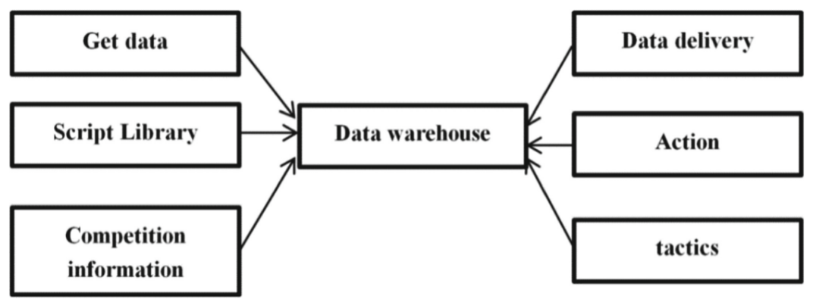
Data Classification
Because the script description language based on pattern is designed for technical and tactical information, it is necessary to classify and integrate the collected data and integrate the data in different data tables to build a new small operational data warehouse.
although the data in the operation database is rich, it is often insufficient for decision-making because it does not hold any historical data which is required in this scenario.

Slide 11
Statistical Analysis
Applying data mining algorithm to deeply mine a large number of data, this paper proposes a data mining algorithm which is more suitable for sports computing.
The main algorithms to be applied are:
Markovian Process
Association Rules Algorithm

Slide 12
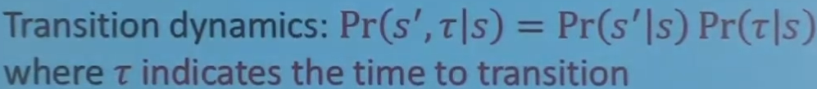
Semi Markovian Process
Markov process principle to data mining, looking for the state transition process which has the greatest impact on the system reliability in the state from serving to scoring.
To be on point Markov process is lacking in time transition state which is a key factor while dealing with sports as it needs to capture very quick actions of their states. This impact caused Semi-Markov process to take a chance where it deals with time spent on each state.

Slide 13
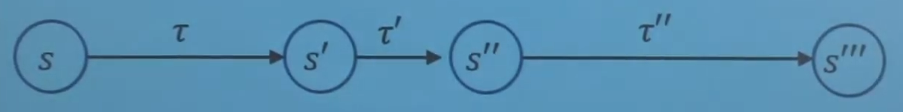
Semi-Markovian contd…
Next step in Semi-Markovian process always depends only on current state and time spent on each state varies.
Each state projects the a state of the player with the time being in each action.

Slide 14
Association Rule Mining
The association rules algorithm is used to find the association information between two or more actions to help coaches make strategic deployment.
It all depends on frequencies of the players actions which creates a mnemonic method in continuation again all the state transitions are being analyzed with time being by semi-markov process

Slide 15
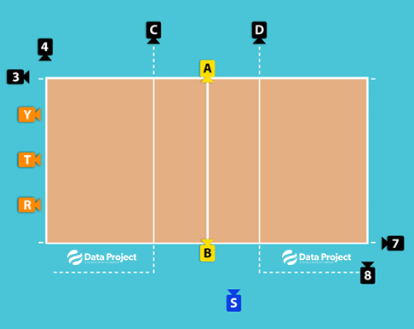
System Management
Video management/ System Management mainly involves some content of video positioning.
At the same time, video detection and video location technology are applied to realize the function of playing video according to script. All that is if the scripts does not work anymore the coaches have to change the appropriate scripts so that the new script is written into the database instead of the old script.

Slide 16
References
https://link-springer-com.libaccess.sjlibrary.org/content/pdf/10.1007%2F978-3-030-87903-7_27.pdf
https://www.dataproject.com/Products/EU/it/Volleyball/DataVolley4
https://www.sciencedirect.com/topics/computer-science/semi-markov-process
https://ascelibrary.org/doi/abs/10.1061/%28ASCE%29IS.1943-555X.0000112
https://www.youtube.com/watch?v=1nuTmzqKQyE&ab_channel=PascalPoupart
http://myweb.sabanciuniv.edu/rdehkharghani/files/2016/02/The-Morgan-Kaufmann-Series-in-Data-Management-Systems-Jiawei-Han-Micheline-Kamber-Jian-Pei-Data-Mining.-Concepts-and-Techniques-3rd-Edition-Morgan-Kaufmann-2011.pdf
https://patents.google.com/patent/CN102339140A/en

